Slide 1


















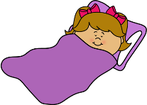




Self-actualization
Morality
Creativity
Spontaneity
Problem Solving
Lack of Prejudice
Acceptance of Facts
Respect of Others
Respect by Others
Esteem
Self-Esteem
Confidence
Achievement
Love and belonging
Family
Friendship
Relationship
Safety needs
Security of body
Resources
Morality
Employment
Property
Physiological needs
Food
Water
Sleep
Breathing
Clothing
Shelter

